Slide 1



ASP.NET MVC Introduction
ASP.NET MVC
Introduction
SoftUni Team
Technical Trainers
Software University
http://softuni.bg

Slide 2
Have a Question?
sli.do #CSharpWeb

Slide 3
ASP.NET History
Classic ASP introduced in late 1990's
2002 – ASP.NET 1.0 (Web Forms)
2008 – ASP.NET 3.5 (First version of MVC)
Two more versions in next two years
2010 – ASP.NET 4 (VS 2010, MVC 2.0, Razor)
2012 – ASP.NET 4.5 (First version of Web API, VS 2012)
2013 – SignalR, Bootstrap 3, Web API 2, EF6, OWIN
2015 – ASP.NET Core, Roslyn, OWIN 2.0

Slide 4
Microsoft Web Platform
Sites
Services
Web Forms
Web Pages
MVC
Web API
SignalR
ASP.NET

Slide 5
Microsoft Web Platform
Sites
Services
Web Pages
MVC
Web API
SignalR
ASP.NET Core

Slide 6
ASP.NET vs ASP.NET Core
Requires Windows
Web Forms, Web Pages, MVC
.NET Framework
Cross platform
Web Pages, MVC
.NET Core & .NET Framework
Dependency injection out of the box

Slide 7
Development styles in Web Pages/MVC/WebForms
 | Development style
Web Forms | Rapid development using a rich library of controls that encapsulate HTML markup
MVC | Full control over HTML markup, code and markup separated, and easy to write tests. The best choice for mobile and single-page applications (SPA).
Web Pages | HTML markup and your code together in the same file

Slide 8
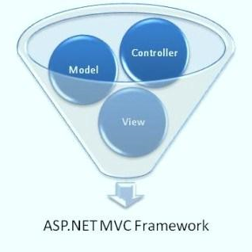
ASP.NET MVC
Runs on top of ASP.NET
Not a replacement for Web Forms
Leverages the benefits of ASP.NET
Embraces the Web
SEO-friendly URLs, HTML 5, SPA
Adopt REST concepts
Uses the MVC pattern
Conventions and Guidance
Separation of concerns

Slide 9
ASP.NET MVC (2)
Tight control over markup
Testable
Loosely coupled and extensible
Convention over configuration
Razor view engine
One of the greatest view engines
With IntelliSense, integrated in Visual Studio
Reuse of current skills (C#, EF, LINQ, etc.)
Application-based (not scripts like PHP)

Slide 10
Extensible
Replace any component of the system
Interface-based architecture
Almost anything can be replaced or extended
Model binders (request data to CLR objects)
Action/result filters (e.g. OnActionExecuting())
Custom action result types
View engine (Razor, WebForms, NHaml, Spark)
View helpers (HTML, AJAX, URL, etc.)
Custom data providers (ADO.NET), etc.

Slide 11
Clean URLs
REST-like URLs
/products/update
/blog/posts/2013/01/28/mvc-is-cool
Friendlier to humans
/product.aspx?catId=123 becomes /products/chocolate/
Friendlier to web crawlers
Search engine optimization (SEO)

Slide 12


Helpful Visual Studio Extensions
Web Extension Pack 2015 – adds a dozen of extensions that increase productivity in the development process

Slide 13
Summary
ASP.NET MVC is a great platform for developing Internet applications
Visual Studio is the main development tool for creating ASP.NET MVC applications
Almost everything in ASP.NET MVC is a package

Slide 14

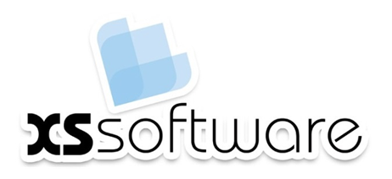






ASP.NET MVC Introduction
https://softuni.bg/courses/

Slide 15
License
This course (slides, examples, demos, videos, homework, etc.) is licensed under the "Creative Commons Attribution-NonCommercial-ShareAlike 4.0 International" license

Slide 16






Free Trainings @ Software University
Software University Foundation – softuni.org
Software University – High-Quality Education, Profession and Job for Software Developers
softuni.bg
Software University @ Facebook
facebook.com/SoftwareUniversity
Software University @ YouTube
youtube.com/SoftwareUniversity
Software University Forums – forum.softuni.bg

